Slide 1
CSE449 Task 2
Group 11
Sadiul Arefin Rafi ST
Sania Azhmee RA

Slide 2
COMPARATIVE ANALYSIS OF CLOUD AND FOG ENVIRONMENT BASED ON NETWORK USAGE AND COST OF EXECUTION USING IFOGSIM

Slide 3
CCTV usage in organizations
In our modern world 24/7 surveillance has become prevalent through the use of CCTV camera.
In addition to that, The number of CCTV cameras used by organizations around the world is increasing exponentially with the increase of surveillance infrastructure.
Typically in a large organization, to better use the data from CCTVs, we have to run it through video processing system to extract the data we need.

Slide 4
Challenges
As CCTV camera technology improves, along with the increase in video length the video quality and size of video data have also been increasing.
Typically in a large organization, to better use the data from CCTVs, we have to run it through video processing system to extract the data we need.
This has to be done on a local host machine which require high specifications to perform such rigorous task
This means a specific machine is dedicated to a certain number of CCTVS

Slide 5
Proposed Solution
The purpose of our research is to decrease the overall cost of execution and the total network usage in a Cloud setup by implementing a Fog setup.
This would allow users to offload the necessary video processing and analysis to the Fog servers and reduce the need to have a host machine with high specifications
This would also let multiple clusters of CCTVs reuse the resources in a single Fog Server at different time intervals.

Slide 6
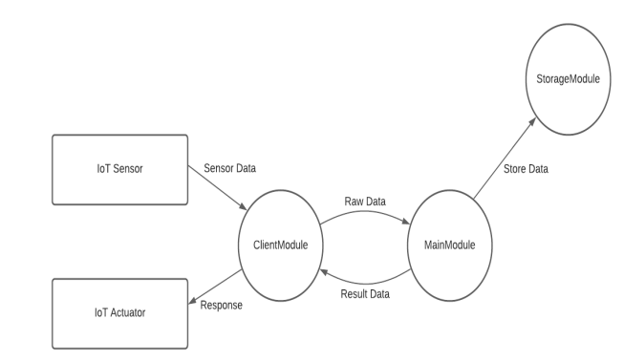
Methodology
We will be using iFogSim which is a Java-based simulation toolkit
This will be three stage architecture with three modules. 1) ClientModule 2)MainModule 3)StorageModule
Iot Sensor, IoT Actuator and CCTVs will be connected to ClientModule

Slide 7
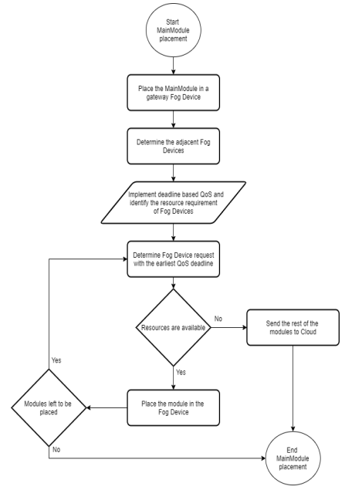
Main Module will be inside Fog computers and Deadline based Qos and resource requirement of the Fog Devices will be implemented here.
We determine if the current Fog Device has the resources available to meet the earliest QoS deadline. If it does, then we place the module in the Fog Device and keep repeating it if there are other modules left to be placed.
If, at any point the Fog Device does not have the necessary resources available, then the modules are sent to the cloud to be processed.

Slide 8
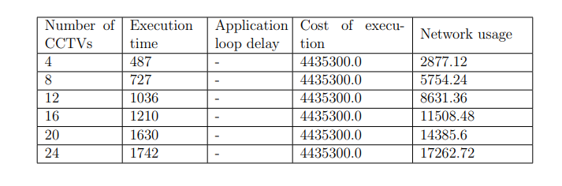
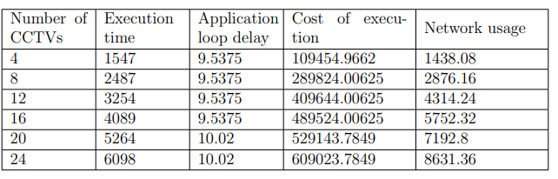
comparison
Table 4.1: Result Analysis of the Cloud Environment
Table 4.2: Result Analysis of the Fog Environment
we can clearly see that using fog computer can reduce both cost of execution and network usage

Slide 9
Related research
- C. Puliafito, E. Mingozzi, and G. Anastasi, “Fog computing for the internet of mobile things: issues and challenges,” in 2017 IEEE International Conference on Smart Computing (SMARTCOMP), pp. 1–6, IEEE, 2017
-ahmud and R. Buyya, “Modelling and simulation of fog and edge computing environments using ifogsim toolkit,” Fog and edge computing: Principles and paradigms, pp. 1–35, 2019

Slide 10
Conclusion
In this paper, it has been shown that offloading the computation of CCTV footage for video processing and analysis to a Fog Server, rather than doing it in a local machine, can help in decreasing the total network usage and the cost of execution in a network.

